Slide 1
Health Inequities in Saskatoon:
An Update on Reports and Actions
Dr C Neudorf
Nov 8, 2022

Slide 2
Objectives
To be able to define the concepts of health equality, health inequity, and health equity
To understand the history and purpose of health inequities reporting in Saskatoon and beyond
To understand how to use health inequity data to improve health equity by incorporating a population health approach to health programs, QI, and intersectoral action

Slide 3
Context: a Population Health Approach for health system planning and delivery
Definitions
  Population health approach
  Health Inequality
  Health inequity
Misalignment of health system mission statements and goals with resource allocation, structure and program delivery
Notes:
According to the Public Health Agency of Canada (PHAC) a population health approach “focuses on improving the health status of a population, or sub-population rather than individuals. Focusing on the health of populations also necessitates the reduction of health inequalities in health status between population groups. An underlying assumption of a population health approach is that reductions in health inequities require reductions in material and social inequities. The outcomes or benefits of a population health approach, therefore, extend beyond improved population health outcomes to include a sustainable and integrated health system, increased national growth and productivity, and strengthened social cohesion and citizen engagement
A 2007 review of RHAs showed that most organizations are struggling to operationalize these concepts. It concluded that "an inability to adopt a population health approach may be due as much to government directives to spend new monies elsewhere rather than the particular failings of RHAs". In the healthcare chapter of the book “Social Determinants of Health: Canadian Perspectives”, it is suggested that while health services have historically not contributed as much toward health status as the social determinants of health, “re-engineered services could help make healthcare a bigger influence on our health status.” Frankish CJ, Moulton G, Quantz D, Carson AJ, Casebeer A, Eyles J, Labonte R, Evoy B. “Addressing the non-medical determinants of health: A survey of Canada's health regions” Canadian Journal of Public Health. January/February 2007, Vol.98, No.1 p 41-47
“Social Determinants of Health: Canadian Perspectives”. Edited by Dennis Raphael. 2004 Canadian Scholars Press. Chapter 20 Healthcare and Health by Michael Rachlis p 297-310

Slide 4
Definitions
Health Inequality- differences in health experiences and health outcomes between different populations. Health inequalities may be health inequities if they are due to socially determined circumstances.
Health Inequity- differences which are unnecessary and avoidable and which are also considered unfair and unjust³. They represent differences in opportunity for different populations which result in unfair and unequal life chances, access to services, etc. Arise from gaps related to the social determinants of health.
Health equity – the principle of and commitment to incorporating fairness into health by reducing health inequalities.¹ It implies that all people can reach their full health potential and should not be disadvantaged from attaining it because of their race, ethnicity, religion, gender, sexual orientation, age, disability, social class, socio-economic status, geography or other socially determined circumstances².
1 Braveman P. What are health disparities and health equity? we need to be clear. Public Health Rep 2014; 129 Suppl 2: 5-8.
2 Adapted from Whitehead M, Dahlgren G. Concepts and principles for tackling social inequities in health: levelling up part 1. Copenhagen: World health Organization Regional Office for Europe; 2006.
3 The World Health Organization

Slide 5
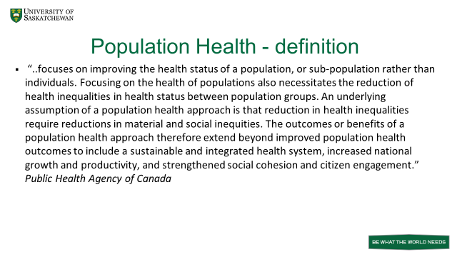

Slide 6
Why Monitor Health Inequities?
  To support intersectoral action (program & policy)
  To increase public awareness and support for change
  To support health system action (program & policy)
Notes:
According to the Public Health Agency of Canada (PHAC) a population health approach “focuses on improving the health status of a population, or sub-population rather than individuals. Focusing on the health of populations also necessitates the reduction of health inequalities in health status between population groups. An underlying assumption of a population health approach is that reductions in health inequities require reductions in material and social inequities. The outcomes or benefits of a population health approach, therefore, extend beyond improved population health outcomes to include a sustainable and integrated health system, increased national growth and productivity, and strengthened social cohesion and citizen engagement
A 2007 review of RHAs showed that most organizations are struggling to operationalize these concepts. It concluded that "an inability to adopt a population health approach may be due as much to government directives to spend new monies elsewhere rather than the particular failings of RHAs". In the healthcare chapter of the book “Social Determinants of Health: Canadian Perspectives”, it is suggested that while health services have historically not contributed as much toward health status as the social determinants of health, “re-engineered services could help make healthcare a bigger influence on our health status.” Frankish CJ, Moulton G, Quantz D, Carson AJ, Casebeer A, Eyles J, Labonte R, Evoy B. “Addressing the non-medical determinants of health: A survey of Canada's health regions” Canadian Journal of Public Health. January/February 2007, Vol.98, No.1 p 41-47
“Social Determinants of Health: Canadian Perspectives”. Edited by Dennis Raphael. 2004 Canadian Scholars Press. Chapter 20 Healthcare and Health by Michael Rachlis p 297-310

Slide 7
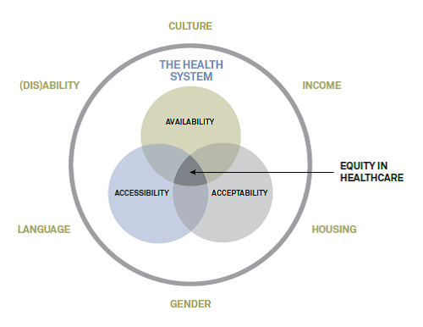
A Framework for Conceptualizing Equity in Healthcare
Notes:
Equitable service-delivery within a health-care system should be consistent regardless of clients’ “personal characteristics”, with the ultimate goal being to match services as closely as possible to the level of need (i.e., if there is a greater need for services, there are more services available).
Accessibility of services refers to the extent to which the health-care system is designed to meet the needs of the health system users, as well as the level of openness to the participation of underserved groups in the planning and evaluation of those services (Bowen, 2001). Issues associated with literacy, language, gender, ethnicity,
and geography can all have substantial impact on the accessibility of the health care system. Equitable access can be defined as “the provision of health services in a way that provides an equal opportunity for all citizens to achieve maximum health” (Bowen, 2001). The ultimate goal is not simply equitable access to health services, but equitable access to health. Availability of services, in simple terms, refers to whether services are provided within a community. Acceptability of services refers to whether services are provided in a way that meets the needs of distinct cultural, linguistic, ethnic, and social groups. The provision of culturally competent services and creation of culturally safe spaces are key components of the acceptability of services. More than simply an awareness of cultural differences, cultural competency relates to a set of “behaviours, attitudes, and policies that come together in a system, agency, or among professionals” that enables effective service delivery in cross-cultural situations (National Health and Medical Research Council, 2005). In Health System Approaches to Promoting Health Equity: A Discussion Paper, Mador (2010) puts forward a visual framework for conceptualizing equity in health care (Figure 2). Within this framework, equity within the health system refers to equal access to health care for people with equal needs

Slide 8
WHO Report “Closing the Gap in a Generation”
  “Where systematic differences in health are judged to be avoidable by reasonable action they are, quite simply, unfair. It is this that we label health inequity. …Reducing health inequities is, …an ethical imperative. Social injustice is killing people on a grand scale.” (Marmot, 2008).

Slide 9
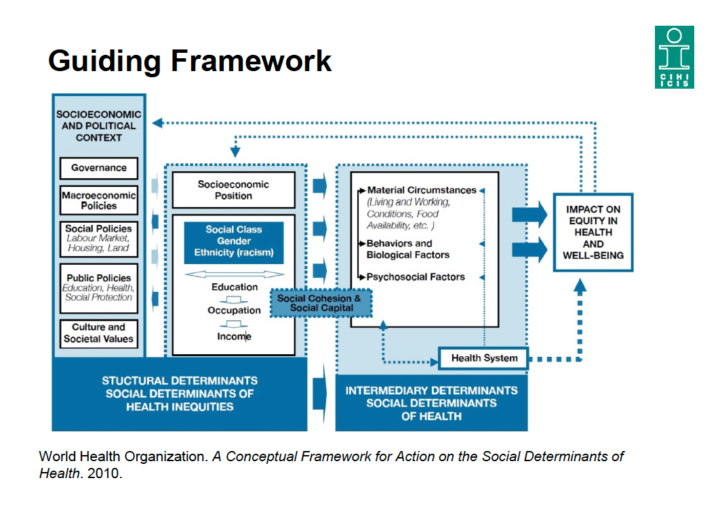

Slide 10
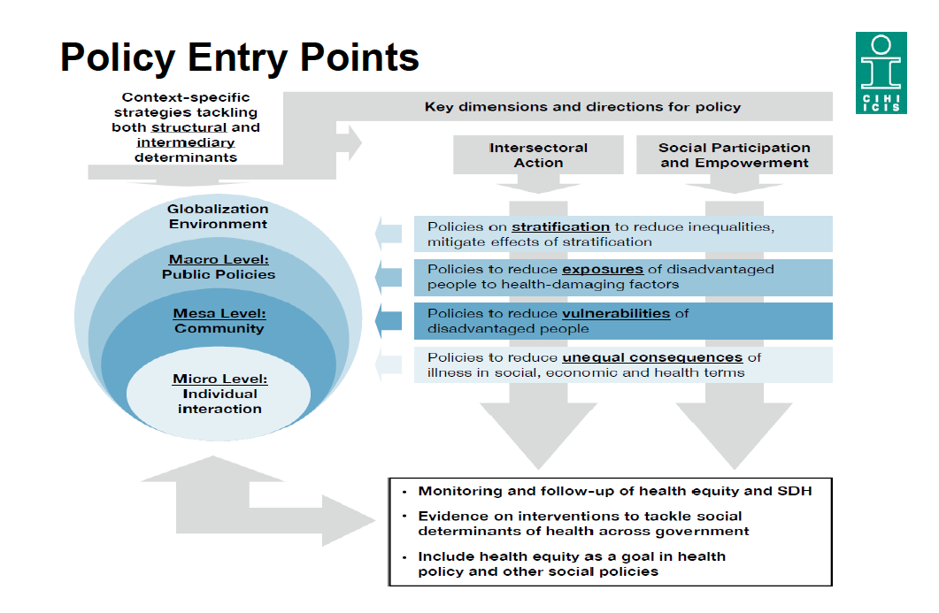

Slide 11
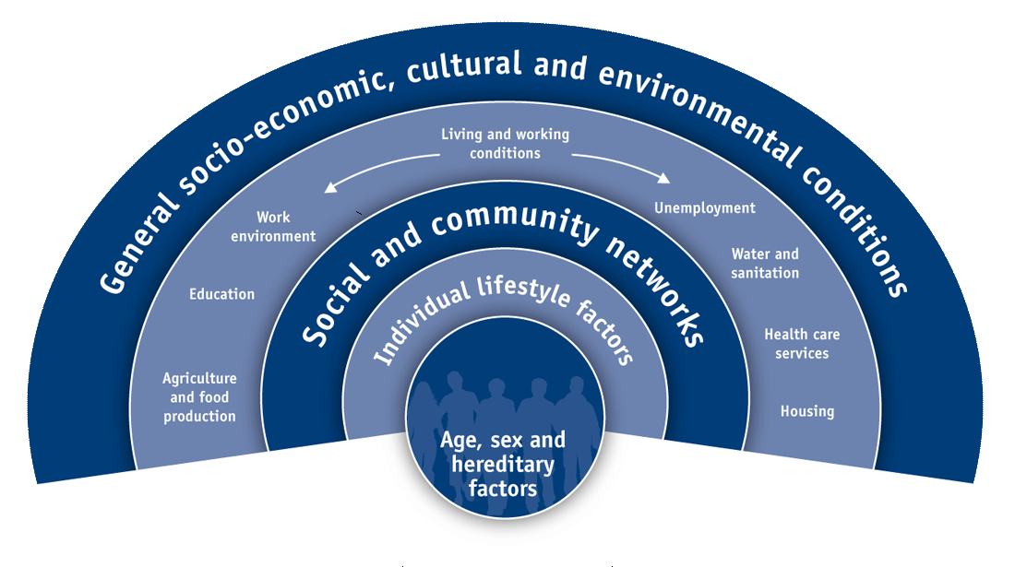
Role of the Health System in Tackling Health Inequalities
Source: Dahlgreen, G. & Whitehead, M. (2006). European strategies for tackling social inequities in health: Levelling up Part 2. World Health Organization.

Slide 12
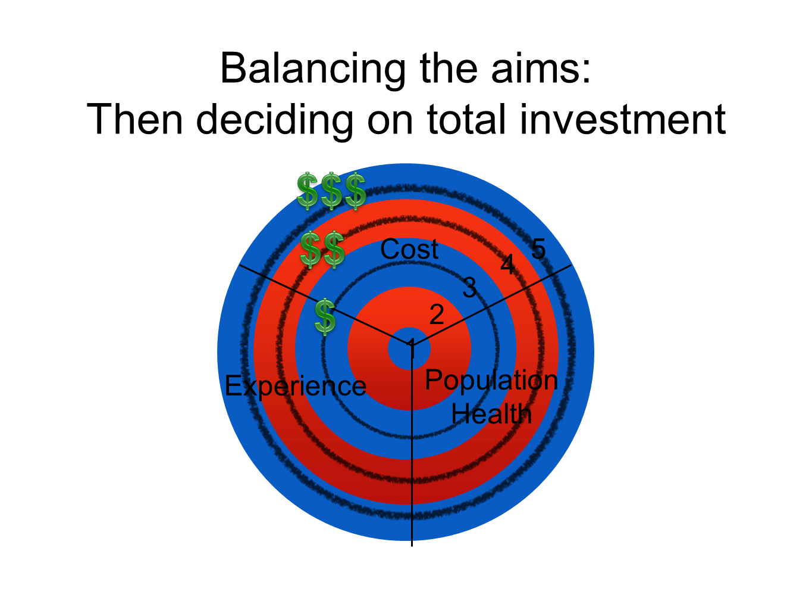

Slide 13
Health System Use of Health Equity Data
At the program/Department level:
  For planning and monitoring quality of disease prevention and health promoting programs and services
At the system planning / quality improvement level:
  For planning and monitoring quality of treatment and rehabilitative programs and services
At the Senior Leadership / Strategic level
  For planning and prioritizing health system programs and services
Neudorf C. Integrating a population health approach into healthcare service delivery and decision-making.
Healthcare Management Forum. 2012: 25(4) 155-159

Slide 14
The Health Equity Journey in Saskatoon and Canada

Slide 15
Timeline
1998-2004: targeted analysis of key population health indicators at small area geography level. Conceptualizing of frameworks/models
2005-2009: Building of Public Health Observatory, published CJPH 5 neighborhood study;Work on ICE research study and published Analysis to Intervention report; Gaps in Health Report by UPHN and CIHI nationally
2009-2012 Health Equity over time report in Saskatoon
2012-2015 Saskatchewan Equity Study; SK Poverty Reduction Advisory Committee report; SPRP work; Poverty Costs report
2016- current UPHN Measuring Trends in Health Inequalities in Urban Canada report, HIRI reports nationally, HESRI reports in Europe; development of tools to impact HiAP decisions

Slide 16
Influence on Regional and provincial intersectoral work
Social Determinants of Health and the PHO: Present
Examples:
Saskatoon Poverty Reduction Partnership – policy work and Saskatoon’s Action Plan to Reduce Poverty
Saskatoon and Region Early Years Partnership – priority setting and partnership development among key stakeholders
Saskatchewan Poverty Reduction Strategy
“Hot-spotting” initiatives (Mental Health & Housing; Multiple Chronic Conditions and low income, etc)
Notes:
Community engagement and additional research has led local leaders of social services sectors to endorse a process for developing a Community Action Plan to Reduce Poverty
Community engagement and health disparities research has led local leaders of social services sectors to form the Saskatoon Poverty Reduction Partnership (SPRP)
Policy options in Analysis to Intervention formed foundation of Saskatoon’s Action Plan to Reduce Poverty

Slide 17
System performance equity indicators

Slide 18
Notes:
It has been important for us to keep the equity agenda front and centre for the board. (ok, maybe not exactly centre, but it’s there!) and our Joint Board Quality and Safety Council expects to see equity as a dimension of quality.
The equity indicator we had been reporting at a board level.

Slide 19
Health care Equity audits/guide

Slide 20
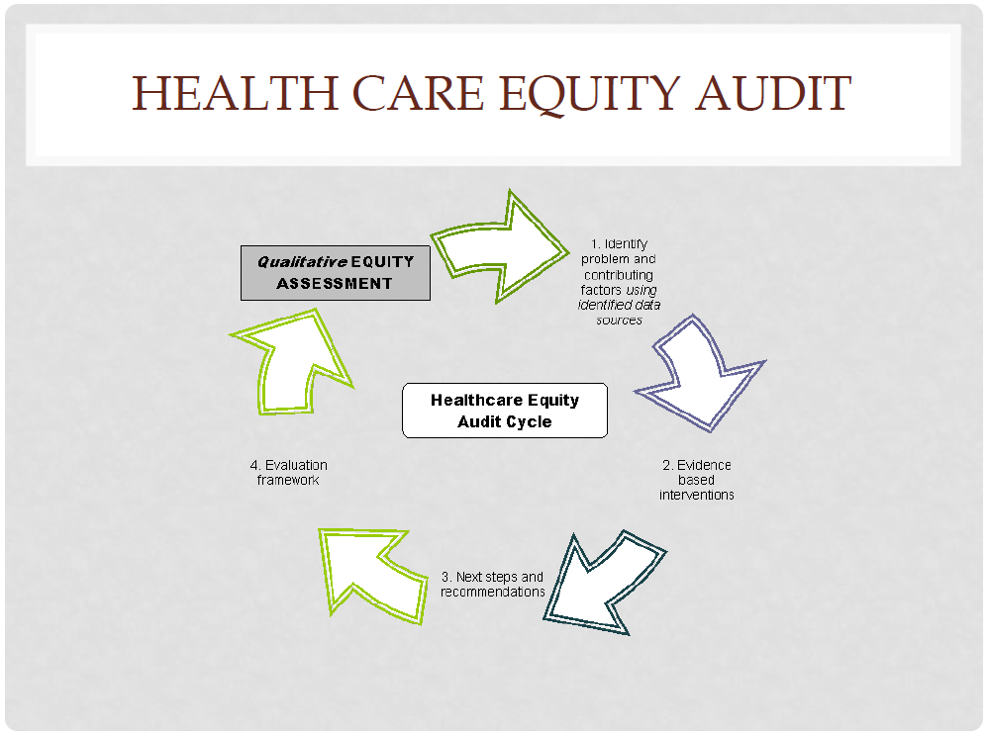

Slide 21
HCEA cycle
Analyse disparities in access and outcome by various dimensions (gender, geography, age, ethnicity)
Compare with measurement of relative need or morbidity to determine if inequities exist
Prioritize areas for quality improvement (areas of greatest concern or greatest potential gains to be made)
Triangulate results from the literature, quantitative analyses and focus groups, surveys on ways to remove barriers for patients, providers and system issues that may be responsible for inequities
Initiate QI projects and evaluate impact on reducing the gaps

Slide 22
Health Care Equity Audit Immunization
Measure Impact and
Amend intervention
Problem
Low Immunisation rates
Core Neighbourhood
Implement Phone based
reminder system for
parents
Lit Review
Of evidence and
best practice
+Parent survey

Slide 23
Health Equity “Over time”: furthering our research evidence
Saskatoon
Saskatchewan
Urban Canada
Future work:
  Impact of COVID on health inequalities
  International comparisons and policy drivers

Slide 24
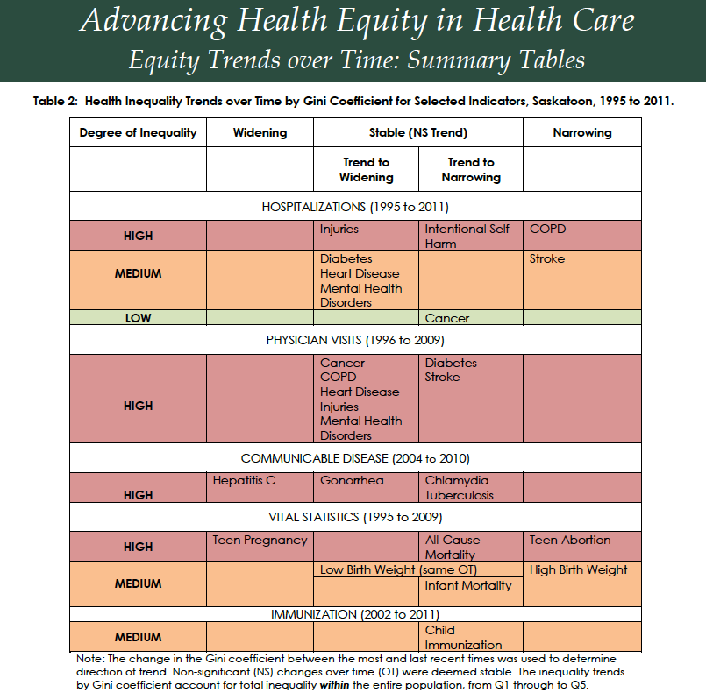

Slide 25
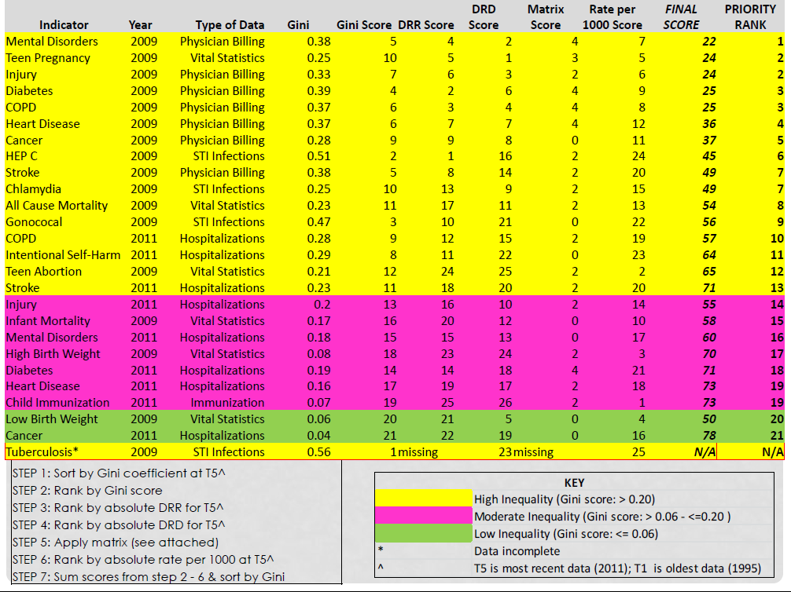

Slide 26
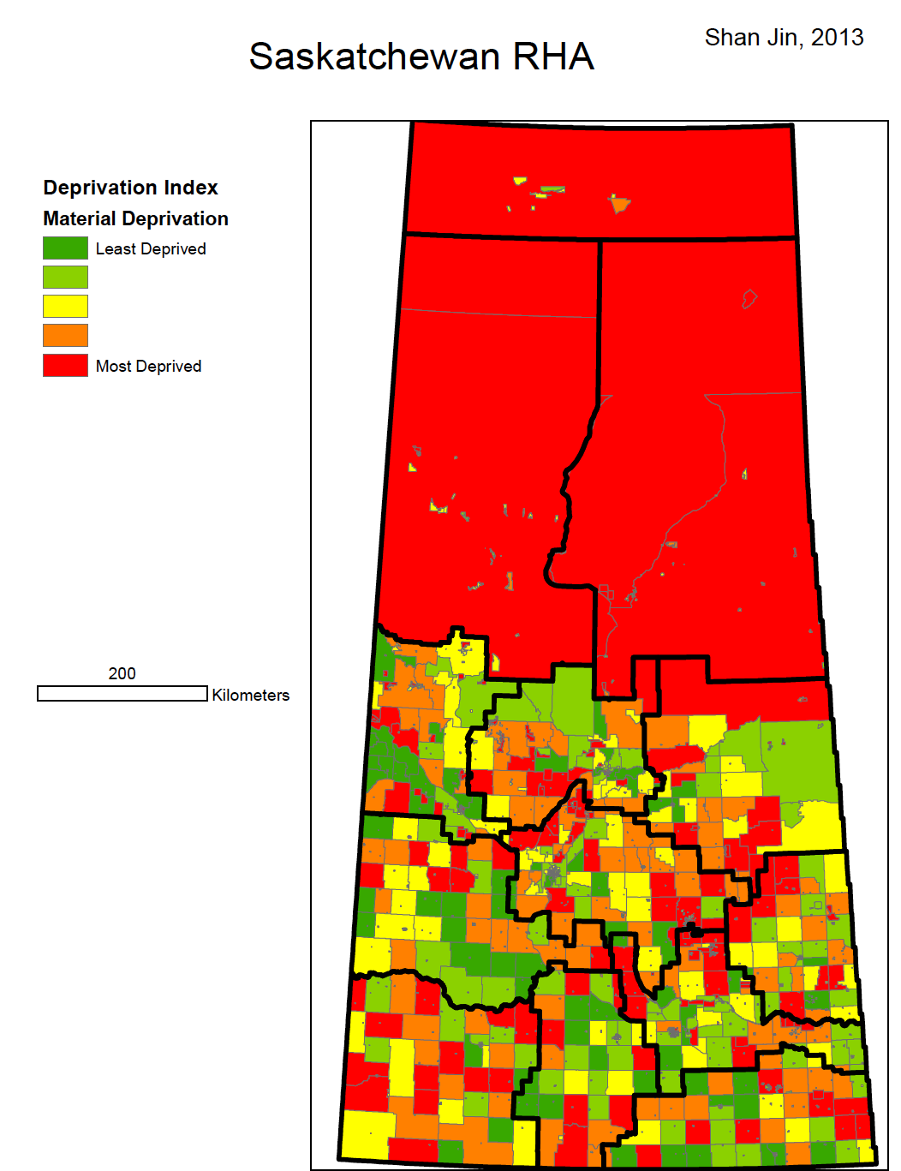
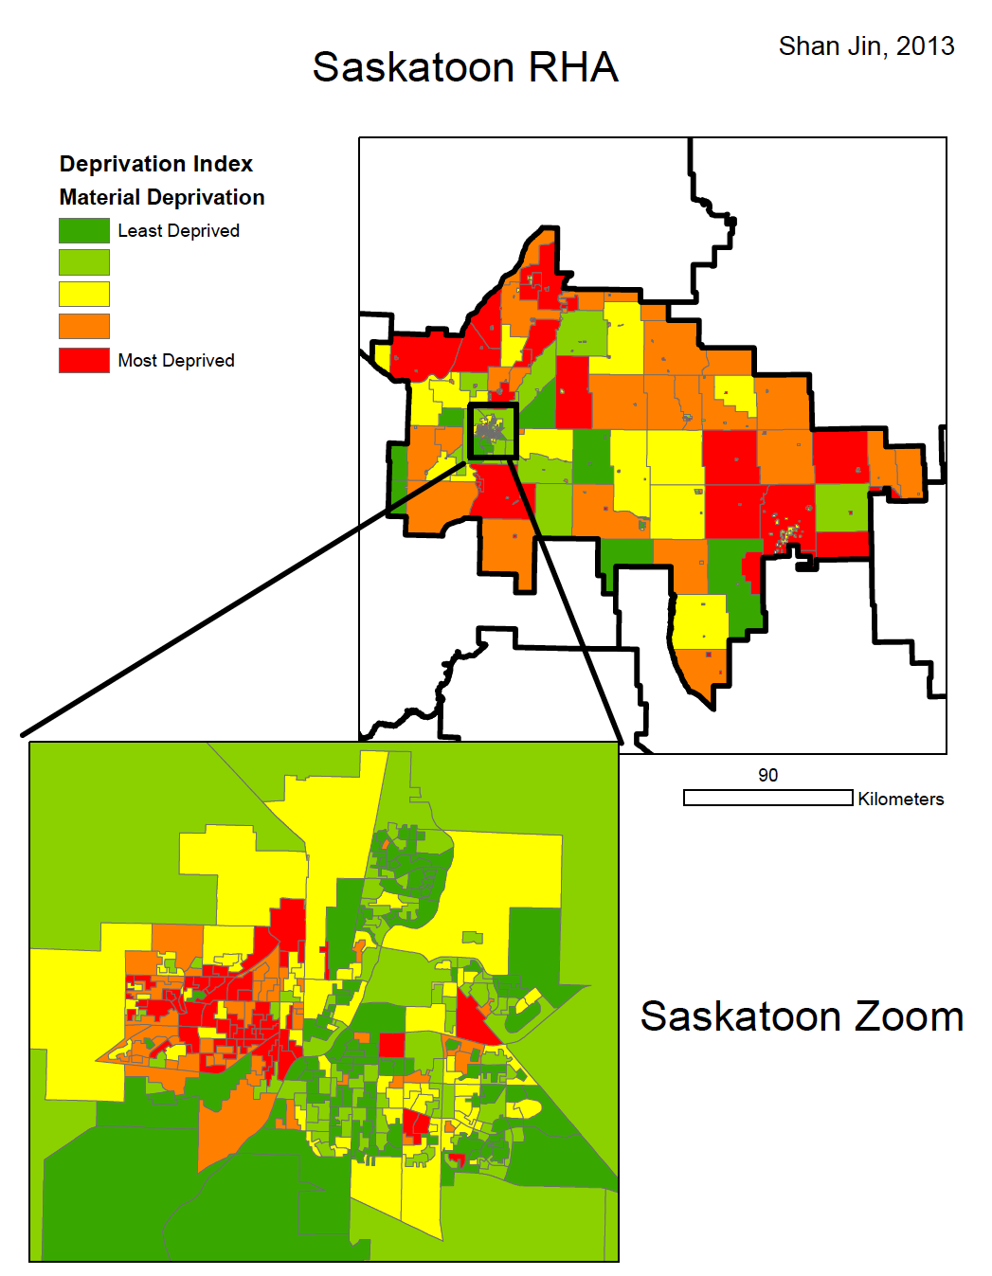

Slide 27
Measuring Trends in Health Inequalities in Urban Canada – Saskatoon 2021
http://uphn.ca/wp-content/uploads/2021/02/MTHIC-Report-English-Report.pdf

Slide 28
Measuring Trends in Health Inequalities in Urban Canada
http://uphn.ca/wp-content/uploads/2021/02/MTHIC-Report-English-Report.pdf

Slide 29
Measuring Trends in Health Inequalities in Urban Canada
http://uphn.ca/wp-content/uploads/2021/02/MTHIC-Report-English-Report.pdf

Slide 30
Measuring Trends in Health Inequalities in Urban Canada
http://uphn.ca/wp-content/uploads/2021/02/MTHIC-Report-English-Report.pdf

Slide 31
National Health Equity reports

Slide 32
COVID Health Equity considerations

Slide 33
COVID Health Equity considerations

Slide 34
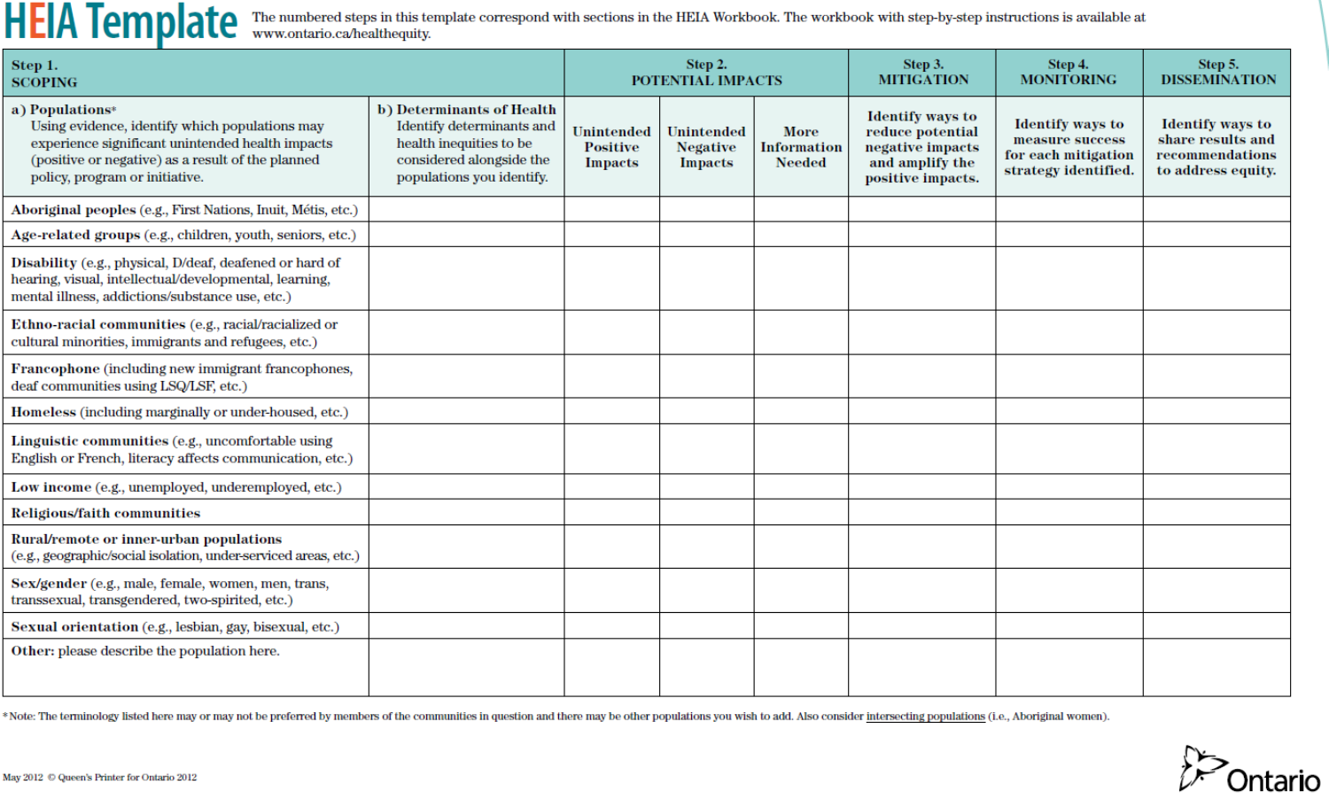
Health Equity Impact Assessments

Slide 36
Implications for health system leaders?
Discussion: What have you tried? What has worked? Where are the barriers? E.g.
  Opportunities to do stratified analysis on all quality metrics to look for possible inequalities and inequities in access, acceptability, appropriateness and outcomes. Then do targeted incremental improvement initiatives, involving patients, improving cultural competence and safety.
  Identification of individuals who may benefit from alternative supports and services (“demand reduction”)
  Provision of preventive services for those without a GP
  Referral to agencies and programs in the community (as opposed to discharge back into same conditions that brought patients to the hospital door)
  Concrete actions on incorporating a population health approach throughout the health system
  Intersectoral collaboration on “wicked problems”, root causes, structural determinants of health and well-being

Slide 37
Intersectoral implications: Ties to Health in All Policies
Improving health equity ultimately requires an intersectoral response to improve social determinants of health.
This is made easier when an all of government approach is taken, where all policies are examined for their potential to improve health and well-being and adapted if they have the potential to do harm
Health equity research has moved beyond quantifying the inequities to study major drivers and policy solutions to impact these drivers to inform decision-makers about the areas of greatest potential impact (both within the health system and in other sectors)
This work needs to be informed by a first voice approach to ensure solutions are both evidence based and aimed at areas of greatest need (“nothing about us without us”)

Slide 38
Health Equity Status Report Initiative (HESRI) WHO Europe

Slide 39
HESRI Health Equity Policy Tool
https://www.who.int/europe/initiatives/health-equity-status-report-initiative/hesri-products

Slide 40
HESRI: Health and health services

Slide 41
HESRI: Income security, social protection

Slide 42
Next Steps
Saskatchewan and Saskatoon:
  SPRP “12 Bold Ideas to eliminate poverty in Saskatoon” campaign
  Basic Income Guarantee coalitions
  Embedding health equity into QI work in Health Authority
  Ties to Wicihitowin conference and TRC Calls to Action, anti – racism
  Intersectoral partnership tables (eg CSWB Partners Table, Early Years Coalition, Housing strategy, etc)
Canada
  Health Inequalities Reporting Initiative (PHAC)
  Canadian Network on HiAP
  UPHN project grant on “What Really Makes Canadians Sick?” (Multilevel estimation of the relative impacts of social determinants on income-related health inequalities in urban Canada: Toward a new Canadian Social Determinants Urban Laboratory)

